Slide 1
Multiplication
Lab 4
By:
Er. Shiva Raj Luitel

Slide 2
Objective
To implement multiplication algorithm using Verilog

Slide 3
Theory
Unsigned multiplication
Booth multiplication

Slide 4
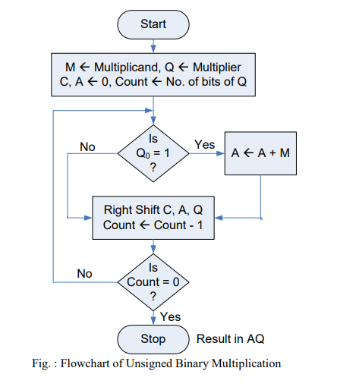
Flowchart for unsigned multiplication

Slide 5
Code
module unsignedmultiplication(M,Q,P);
input[3:0] M;
input[3:0] Q;
output [7:0] P;
reg [7:0] P;
reg Q0;
integer count;
always @(M,Q)
begin
P[7:4]=4'b0;
P[3:0]=Q;
for(count=0; count < 4; count=count+1)
begin
case (P[0])
1: P[7:4]=P[7:4]+M;
default : begin end
endcase
P=P>>1;
end
end
endmodule

Slide 6
Test fixture
initial begin
M = 0;
Q = 0;
// Wait 100 ns for global reset to finish
#100;
M=1;
Q=2;
#100;
M=4;
Q=3;
#100;
// Add stimulus here
end

Slide 7
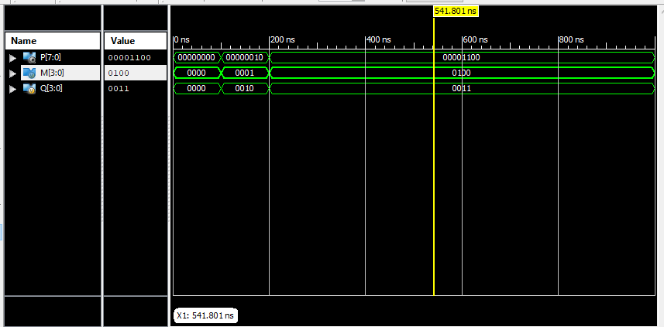
simulation

Slide 8
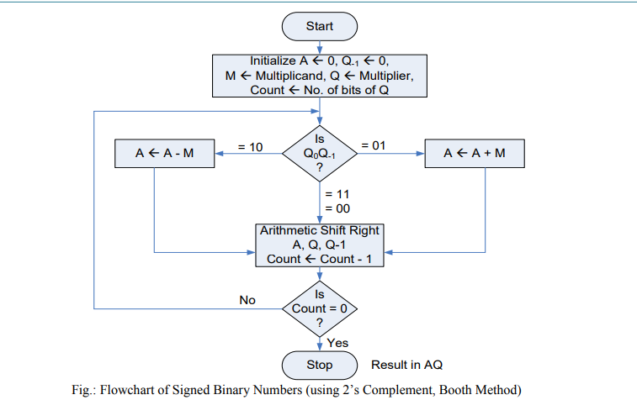
Booth Multiplication

Slide 9
Verilog code
module BoothMulti(X, Y, Z);
input signed [3:0] X, Y;
output signed [7:0] Z;
reg signed [7:0] Z;
reg [1:0] temp;
integer i;
reg E1;
reg signed [3:0] Y1;
always @ (X, Y)
begin
Z[7:4] = 4'd0;
Z[3:0]=X;
E1 = 1'd0;
Y1 = - Y;
for (i = 0; i < 4; i = i + 1)
begin
temp = {X[i], E1};
case (temp)
2'd2 : Z [7 : 4] = Z [7 : 4] + Y1;
2'd1 : Z [7 : 4] = Z [7 : 4] + Y;
default : begin end
endcase
Z = Z >> 1;
Z[7] = Z[6];
E1 = X[i];
end
end
endmodule

Slide 10
Test fixture
X = 0;
Y = 0;
#100;
X=-5;
Y=6;
#100;
X=-6;
Y=5;
#100;
X=-5;
Y=-6;
#100;
end

Slide 11
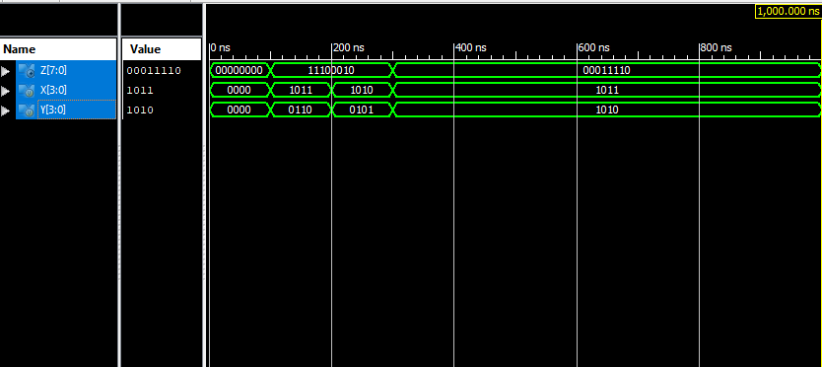
Simulation

